Slide 1
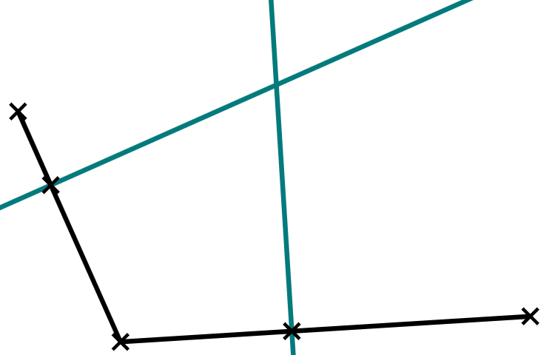
Perpendicular to a given line through a given point
Task A: Perpendiculars at points on shortened line segments
1) Complete the construction of the perpendicular through point Z on each line segment.
C
Z
D
A
Z
B
E
Z
F
G
H
J
I
Z
Z
2) a) Construct the perpendicular to AB through X and the perpendicular to BC through Y.
b) Label the point where the two perpendiculars intersect Z.
Z
c) XBYZ creates a kite. This is because XB = BY, and XZ = YZ.
∠ZXB = ∠ZYB
A
X
B
Y
C

Slide 2
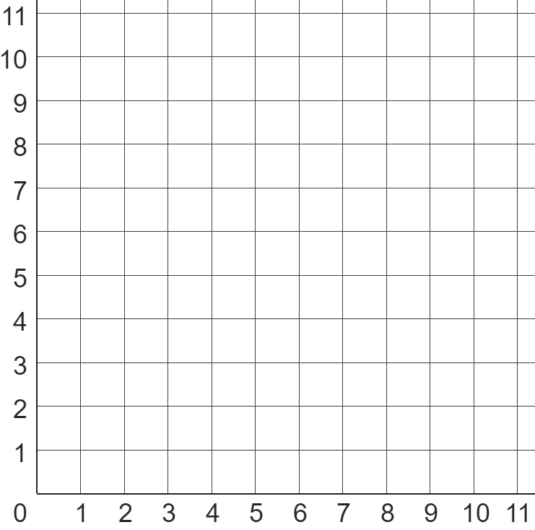
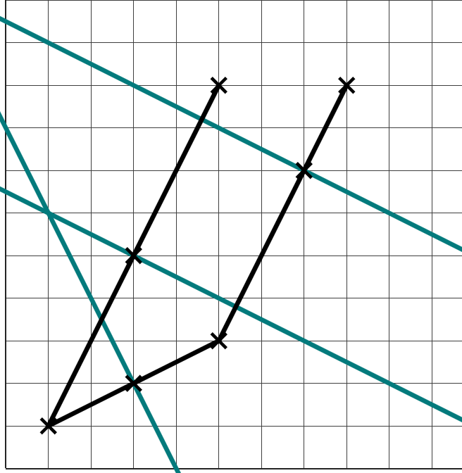
Perpendicular to a given line through a given point
Task B: Perpendiculars at points on extended line segments
1) a) Construct a perpendicular to each line segment through point X.
Decide whether you need to shorten or extend (or both) the line segment.
b) Use a protractor to measure how close each perpendicular is to 90°.
A
B
D
X
C
X
E
X
I
H
G
F
X
X
A(1, 1) | B(5, 3) | C(5, 9) | D(8, 9)
C
D
2) Coordinates A, B, C, and D lie on this coordinate grid.
a) Find the perpendicular to AB through the point (3, 2).
b) Find the perpendicular to AC through the point (3, 5).
c) Find the perpendicular to BD through the point (7, 7).
d) Explain which two perpendiculars are parallel to each other and why.
c)
B
b)
A
a)
The perpendiculars to AC and BD are parallel to each other because the line segments AC and BD are also parallel to each other.
v2.3

Slide 3
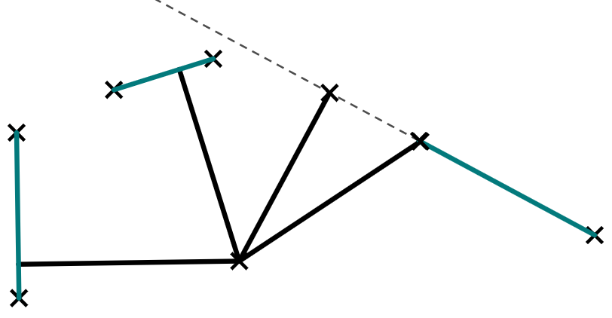
Perpendicular to a given line through a given point
Task C: Perpendiculars through points off a line
1) a) Construct five perpendiculars to AB through each of the five points.
b) Measure the shortest distance from each point to AB.
Y
V
B
A
Z
B
A
X
W
2) A boat, out at sea, needs to find the closest port so that it can refuel.
Which port is the closest to the boat? And at which part of the port should the boat dock?
Port B
Port C
Boat
Port A
Port B is closest.
Be careful, as the shortest distance to the extension of port C is closer - but actual port C is further away.
Mathematics in Education and Industry

